Slide 1
Interview Questions
From: Zihang Qiu

Slide 2
We need to bring up 1000x testers for ramp. How do you ensure tester quality and tester performance are good upon ramp?
How to design the test
What parts to use
What parameters to use as reference
Notes:
1000 testers, what to be tested. If each tester uses different product, e.g., produce 100x products from production line for each tester,

Slide 3
Q1 How to design the test
Run 1000n tests, and each tester should run n tests
n should be big enough to reflect the performance
Should find some way to capture the quality and distinguish parts failure and tester failure
Notes:
1000 testers, what to be tested. If each tester uses different product, e.g., produce 100x products from production line for each tester,

Slide 4
Q1 What parts to use
Golden parts: stable expected output – cannot reflect failure meas
Same parts on different testers – cannot measure in sequence to see performance, some ramp time per runs
Different parts on different testers – unable to track quality, costly
OR we can run tests on same parts for each tester – cannot make sure the test result is correct
E.g., 10 parts run on tester #1 for 10 times,
Notes:
1000 testers, what to be tested. If each tester uses different product, e.g., produce 100x products from production line for each tester,

Slide 5
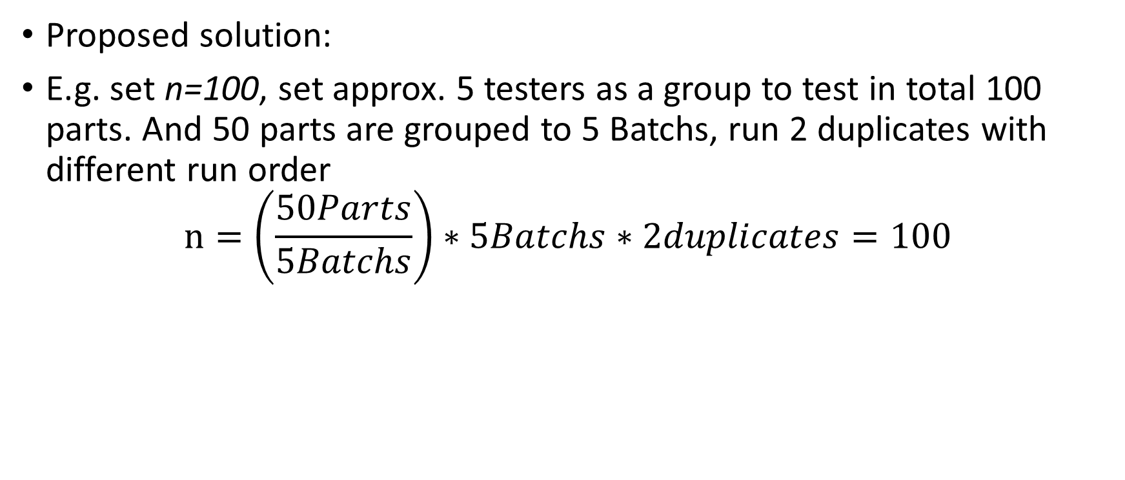
Ramp Design
 | Tester 1 | Tester 2 | Tester 3 | Tester 4 | Tester 5
Parts Batch 1 | 1 | 5 | 4 | 3 | 2
Parts Batch 2 | 2 | 1 | 5 | 4 | 3
Parts Batch 3 | 3 | 2 | 1 | 5 | 4
Parts Batch 4 | 4 | 3 | 2 | 1 | 5
Parts Batch 5 | 5 | 4 | 3 | 2 | 1
Proposed solution:
E.g. set n=100, set approx. 5 testers as a group to test in total 100 parts. And 50 parts are grouped to 5 Batchs, run 2 duplicates with different run order
$$n=\left(\frac{50Parts}{5Batchs}\right)∗5Batchs∗2duplicates=100$$
Notes:
1000 testers, what to be tested. If each tester uses different product, e.g., produce 100x products from production line for each tester,

Slide 6
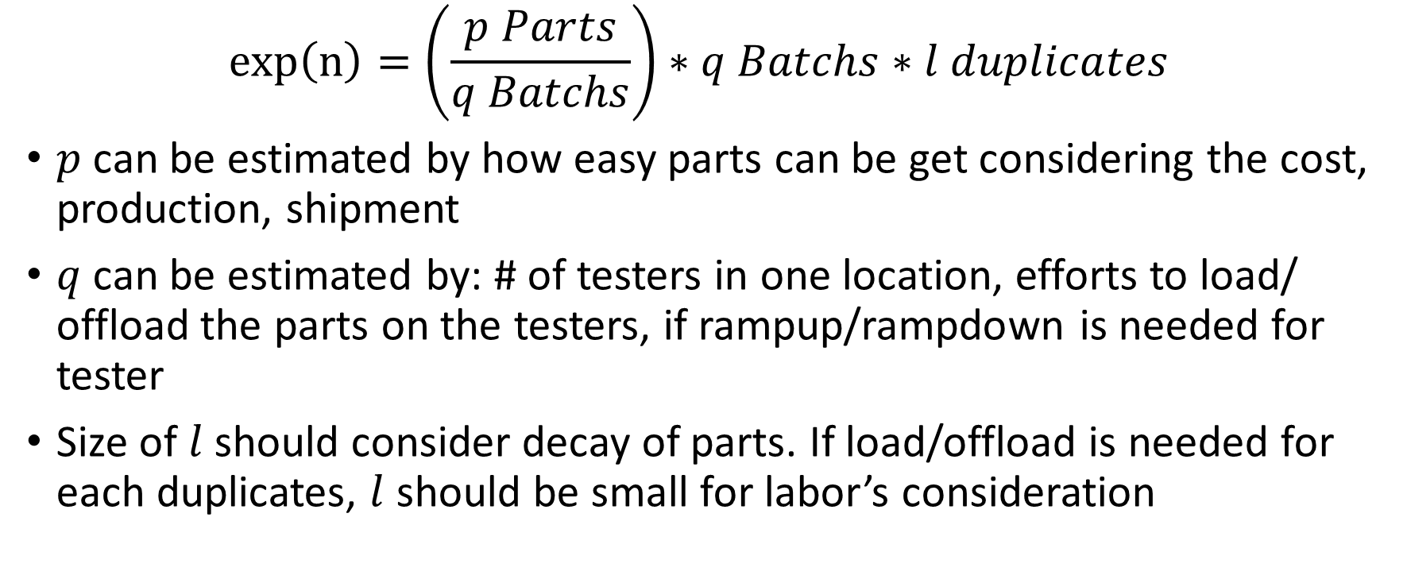
Ramp Design
$$exp\left(n\right)=\left(\frac{p Parts}{q Batchs}\right)∗q Batchs∗l duplicates$$
$p$ can be estimated by how easy parts can be get considering the cost, production, shipment
$q$ can be estimated by: # of testers in one location, efforts to load/ offload the parts on the testers, if rampup/rampdown is needed for tester
Size of $l$ should consider decay of parts. If load/offload is needed for each duplicates, $l$ should be small for labor’s consideration
Notes:
1000 testers, what to be tested. If each tester uses different product, e.g., produce 100x products from production line for each tester,

Slide 7
Q1 What parameters to use as reference
Cp/cpk for each kpi calc.
per batch per tester, to see the consistence within the tester
per batch, to see the measurement consistence over testers
 | Tester 1 | Tester 2 | Tester 3 | Tester 4 | Tester 5
Parts Batch 1 | 1 | 5 | 4 | 3 | 2
Parts Batch 2 | 2 | 1 | 5 | 4 | 3
Parts Batch 3 | 3 | 2 | 1 | 5 | 4
Parts Batch 4 | 4 | 3 | 2 | 1 | 5
Parts Batch 5 | 5 | 4 | 3 | 2 | 1
Notes:
1000 testers, what to be tested. If each tester uses different product, e.g., produce 100x products from production line for each tester,

Slide 8
We need to bring up 1000x testers for ramp. How do you ensure tester quality and tester performance are good upon ramp?
Scenario 1: With golden parts
Avoid multiple tests on same parts in case performance decay
Doesn’t make sense to use different parts for each tester, cost will be high and unnecessary, and it’s very likely we will not have enough parts for performance test
We should have good parts and bad parts for quality test
Scenario 2: With parts not tested
Avoid multiple tests on same parts in case performance decay
Assign
Scenario 3: Need to test with new produced parts
Notes:
1000 testers, what to be tested. If each tester uses different product, e.g., produce 100x products from production line for each tester,

Slide 9
Please run analysis on attach “Data_sample.csv”?
Parts, testers, results, KPIs
Build profiles for parts and testers
Parts with different results, how to determine which one is accurate
Use other parts to fit a prediction model
Are there any testers with inaccurate tests
Cannot verify with current data, but should mark them out
KPIs, failure analysis on parameters more likely to fail
If no limit, fit a distribution and set a limit with, e.g., +-3sigma
Robust cluster modeling

